Slide 1
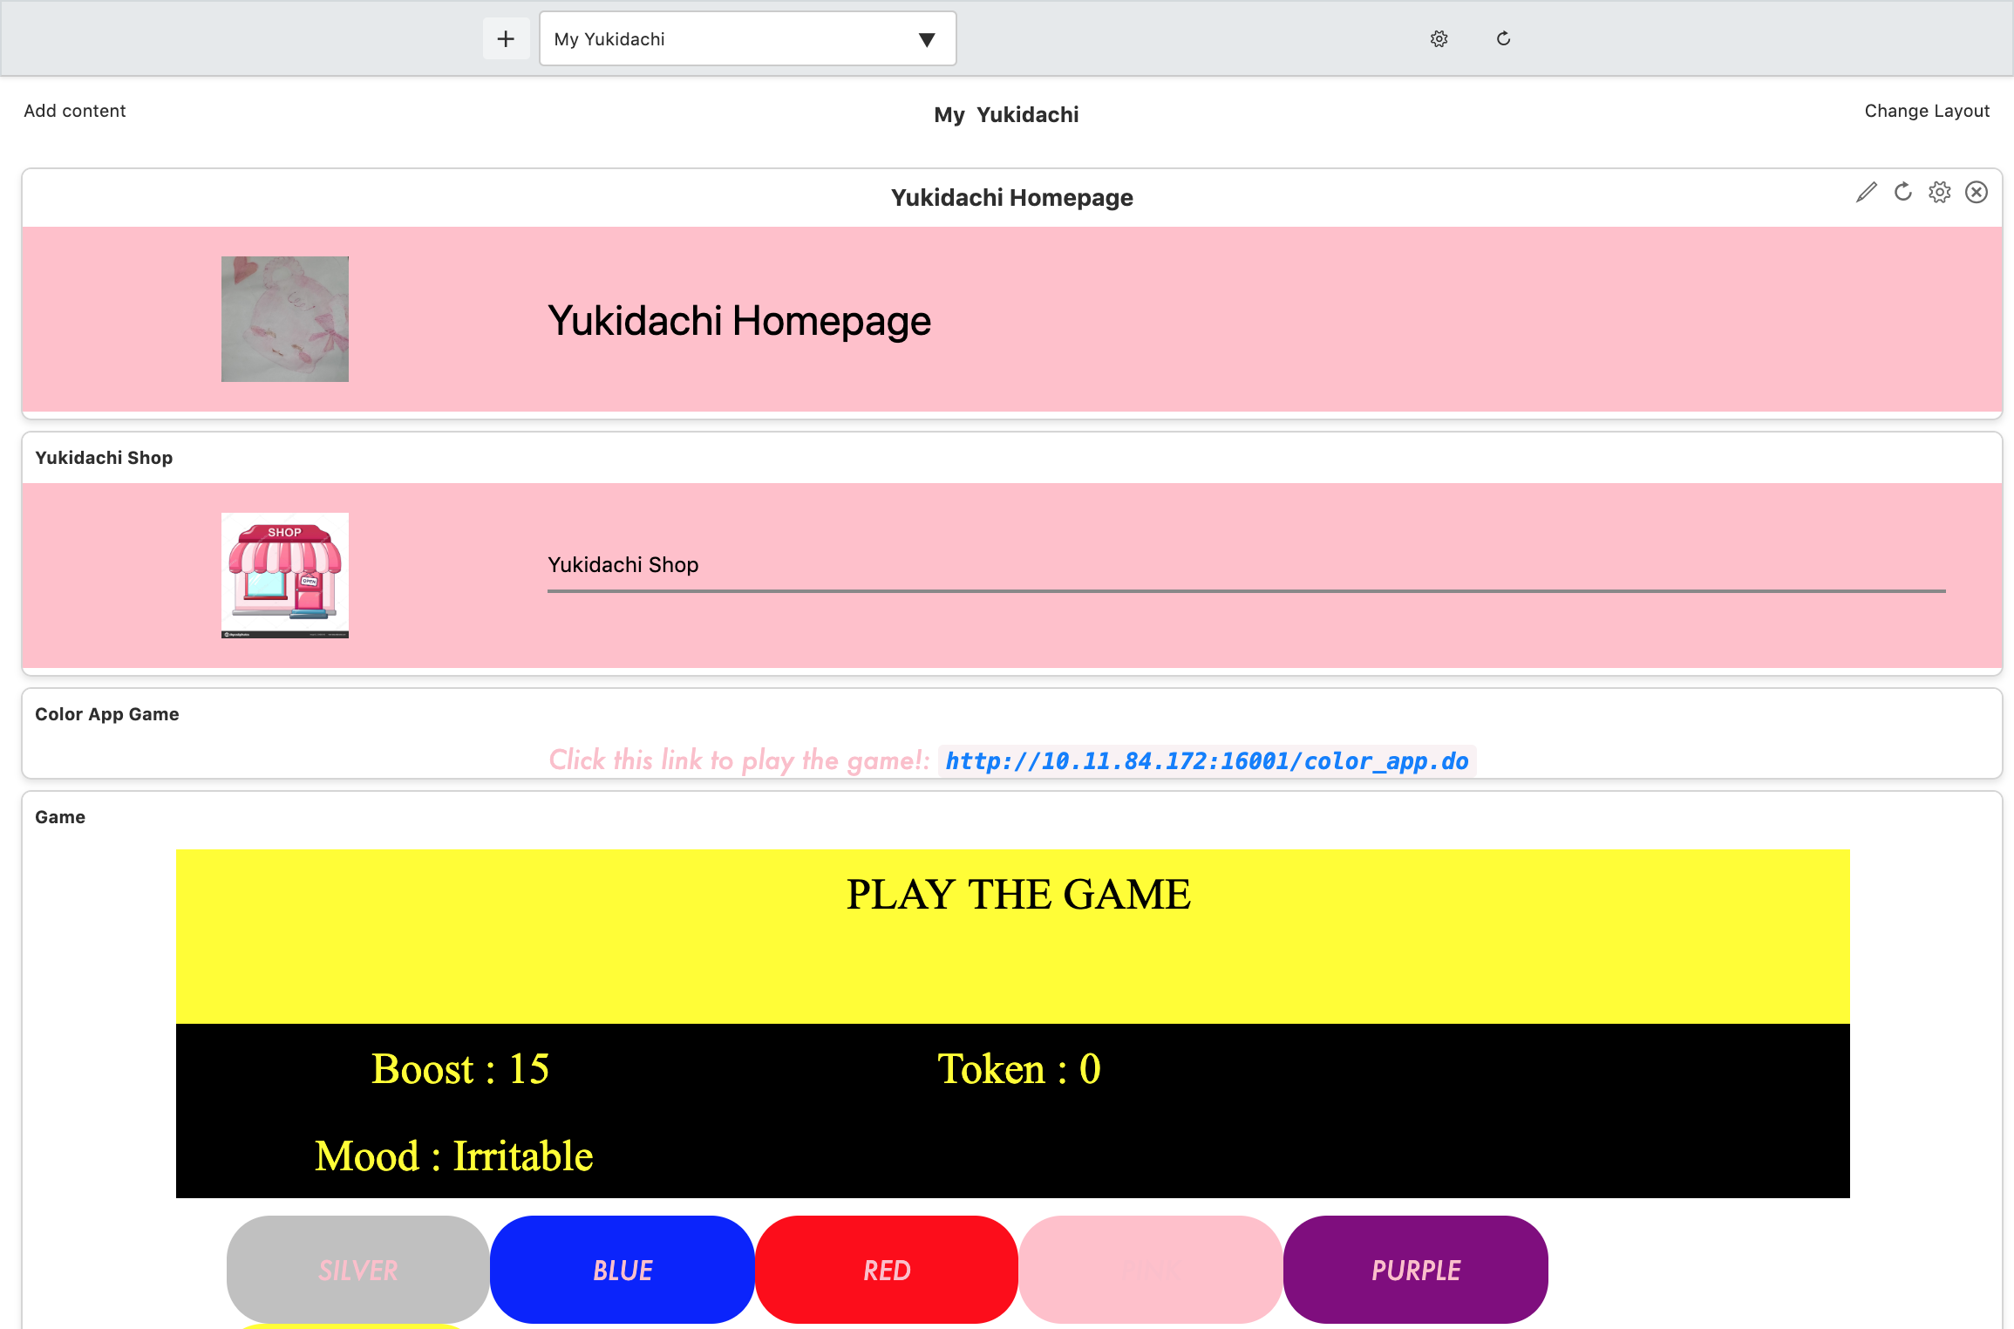
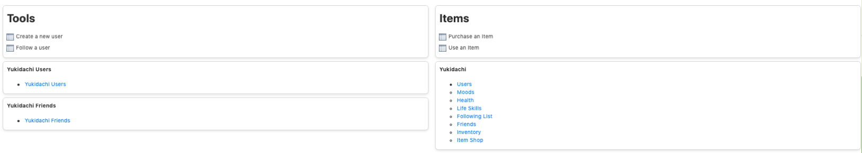
Yukidachi Hackathon
Home Page of the Project
**NOTE: all the images in this PowerPoint are from the actual Yukidachi project that was created during the Hackathon
Team Members : Kenneth Hua, Zoey Shen, Sapna Chandiramani, Vidya Jayaraman

Slide 2
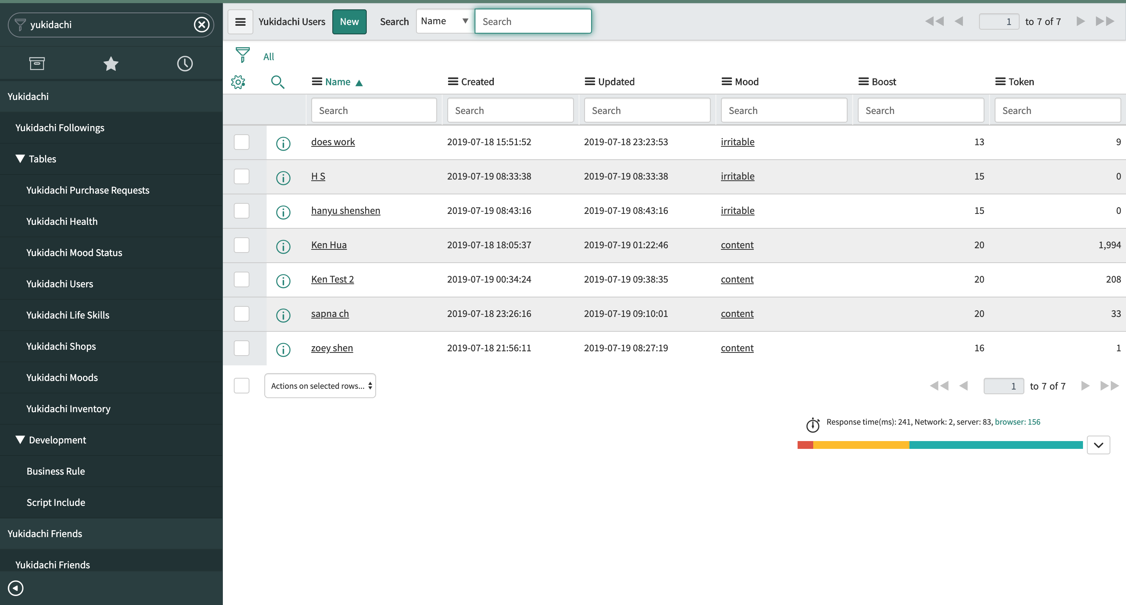
Yukidachi Users
Created a table for all of the Yukidachi users
Table shows the Mood, Boost points and Tokens

Slide 3
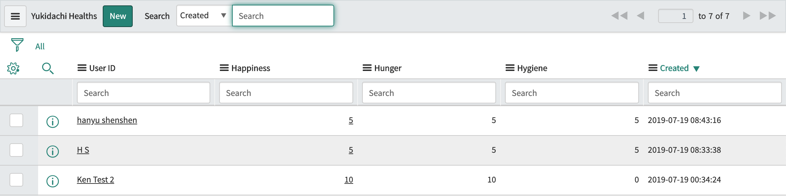
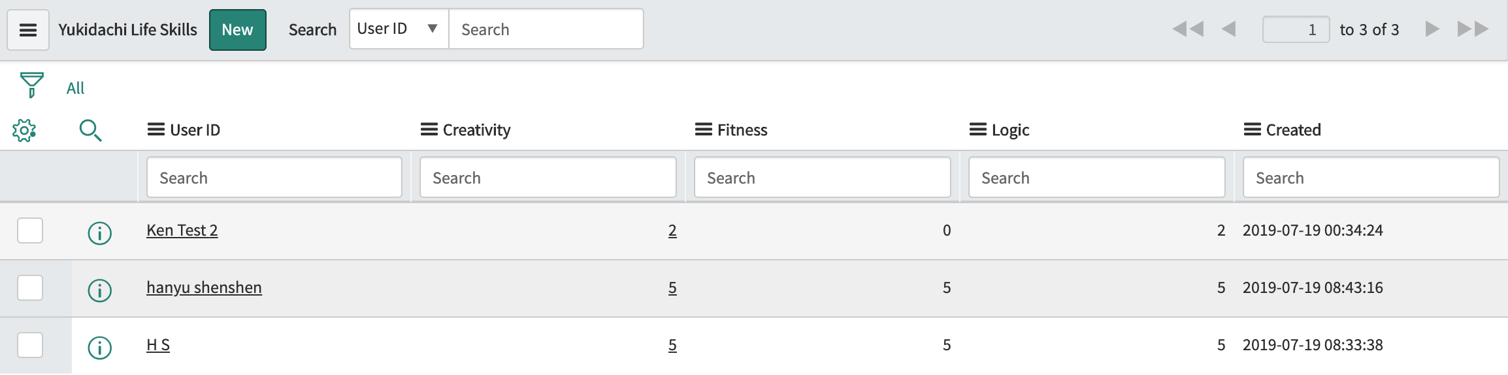
Yukidachi’s Health & Life Skills
Calculated the Health (Happiness, Hunger, Hygiene) out of 30 boost points
Health can be gained by playing games and using items
Life skills (Creativity, Fitness, Logic) can be gained by using items

Slide 4
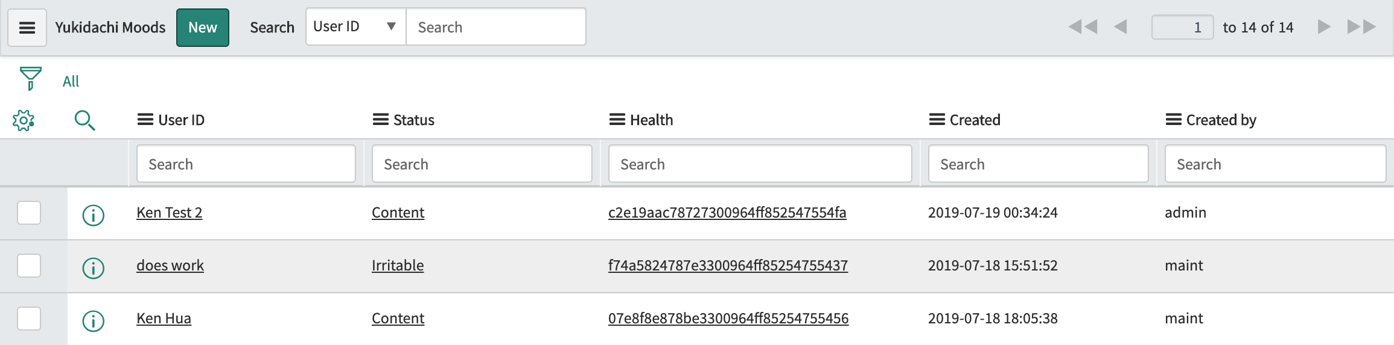
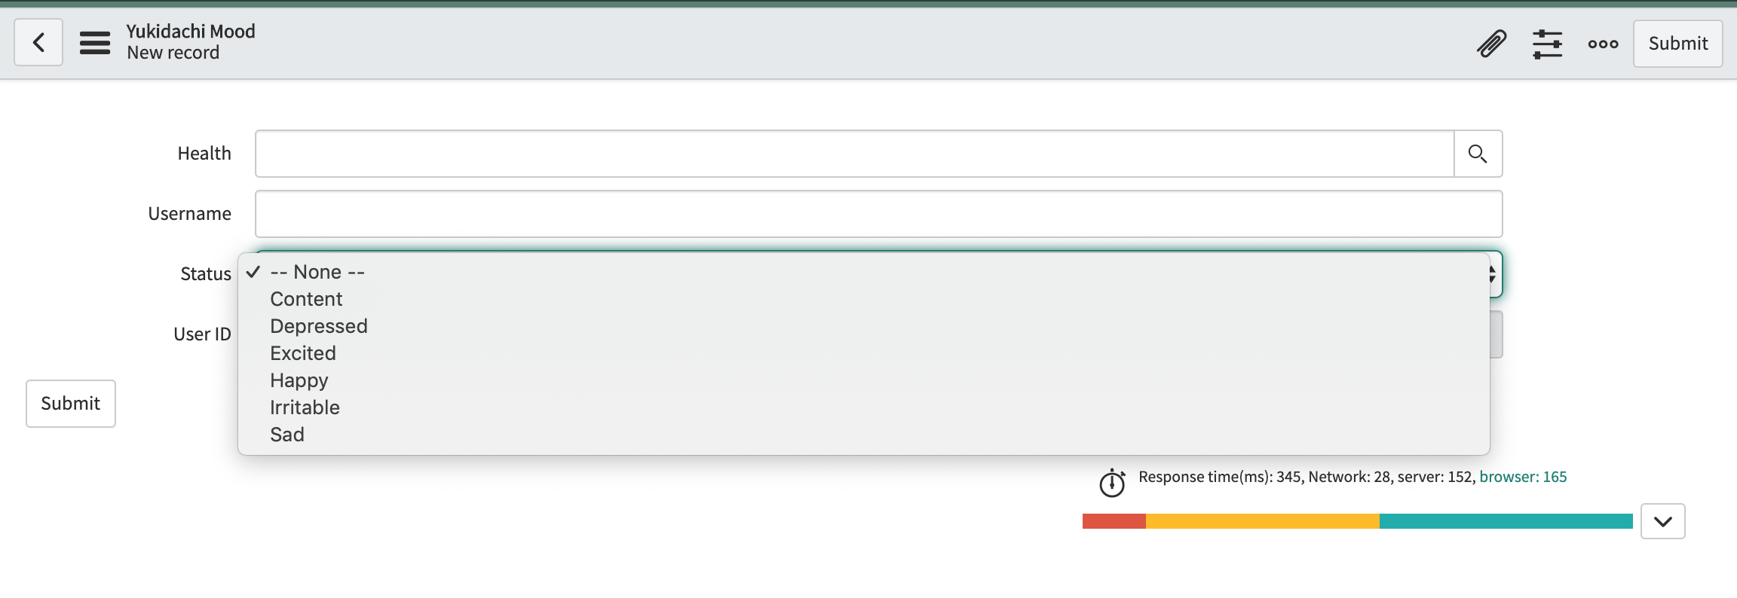
Yukidachi Moods
6 moods calculated by boost points:
1-5 : depressed
6-10: sad
11-15: irritable
16-20: content
21-25: happy
26-30: excited

Slide 5
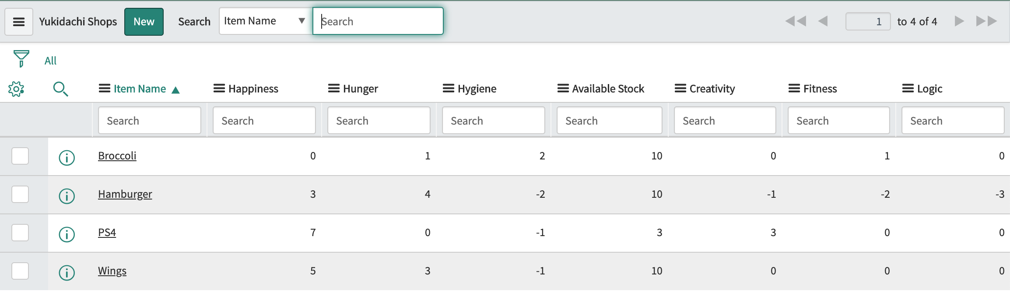
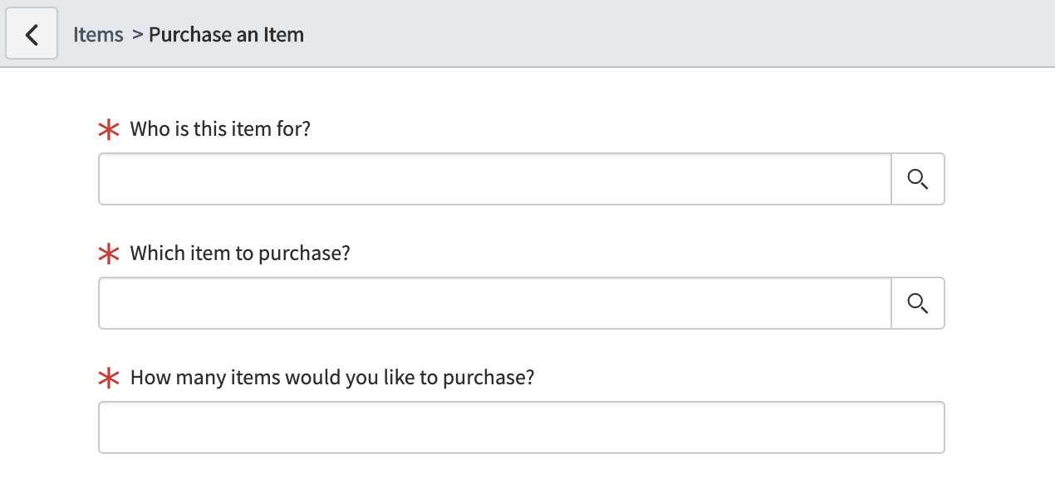
Yukidachi Shop
Table of items with details about the items (Health & Life Skill points) in the shop
Purchase item using purchase request

Slide 6
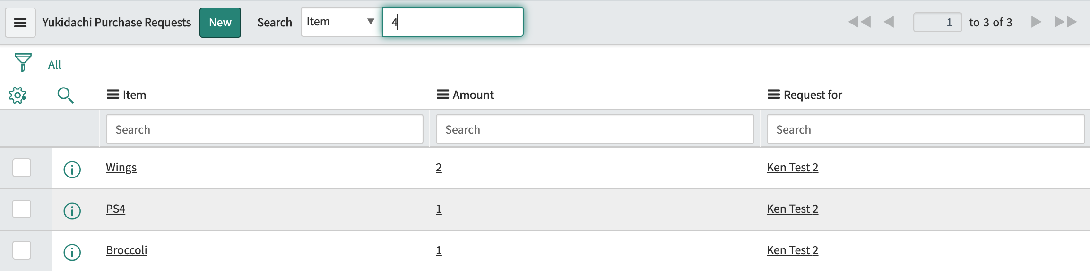
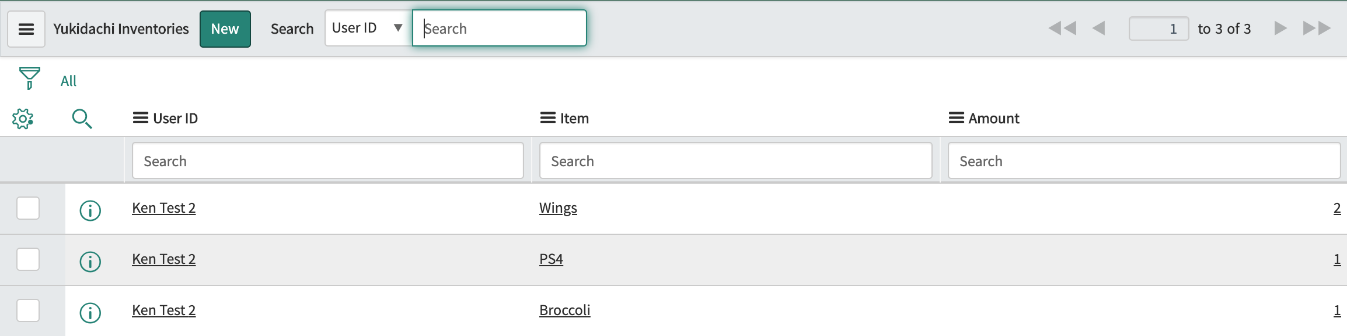
Yukidachi Inventory
Lists all the items the user purchased
Lists all the items in the user’s inventory

Slide 7
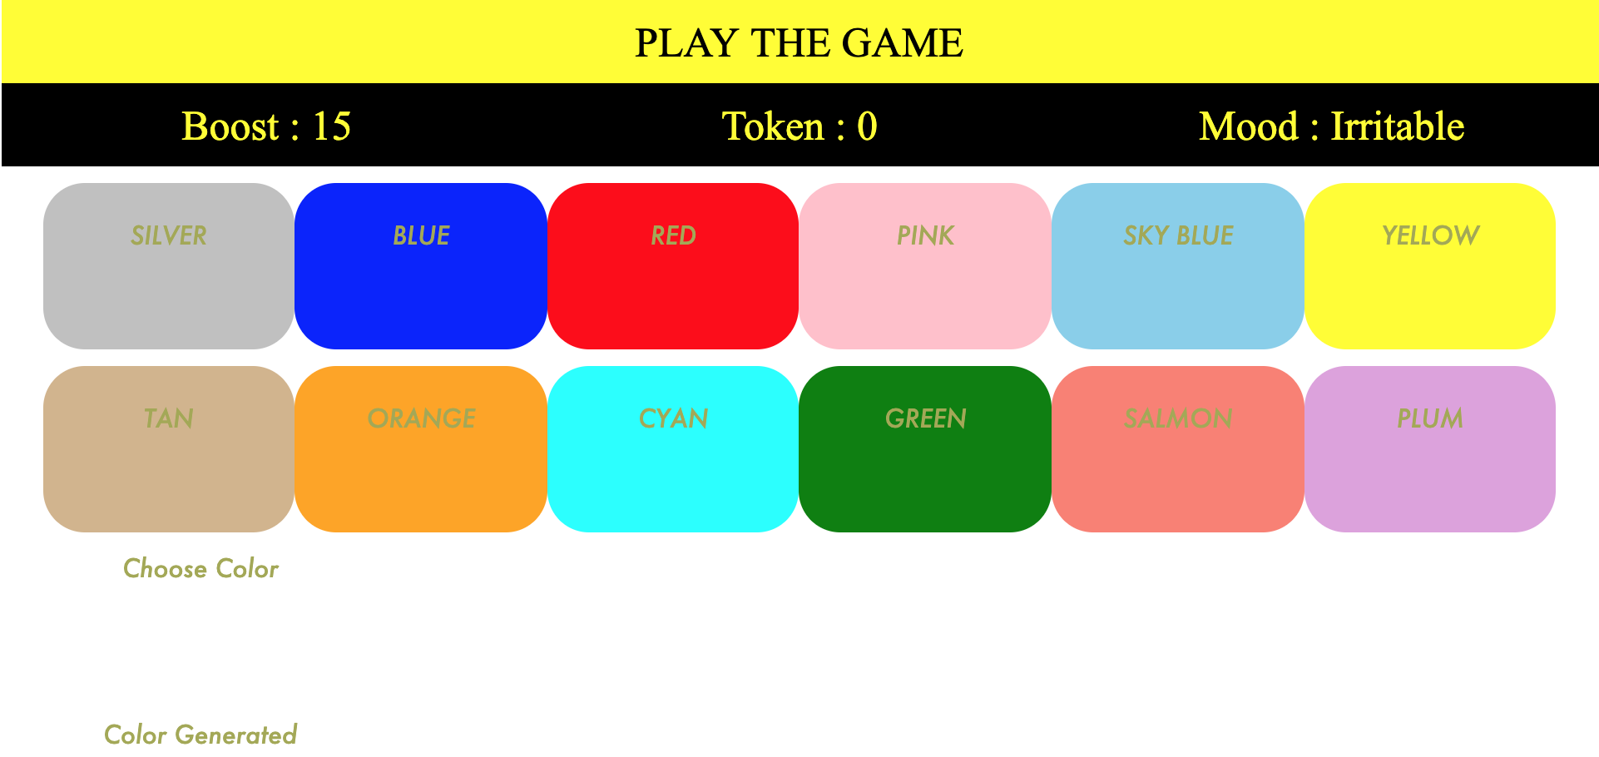
Game
Color app in which the character picks a color (out of 12 colors) that matches the color the computer picks
The computer generates a color randomly
If character wins, they get 2 tokens and 1 boost point
If character loses, they get 1 token and 1 boost point

Slide 8
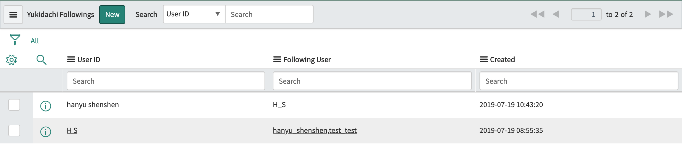
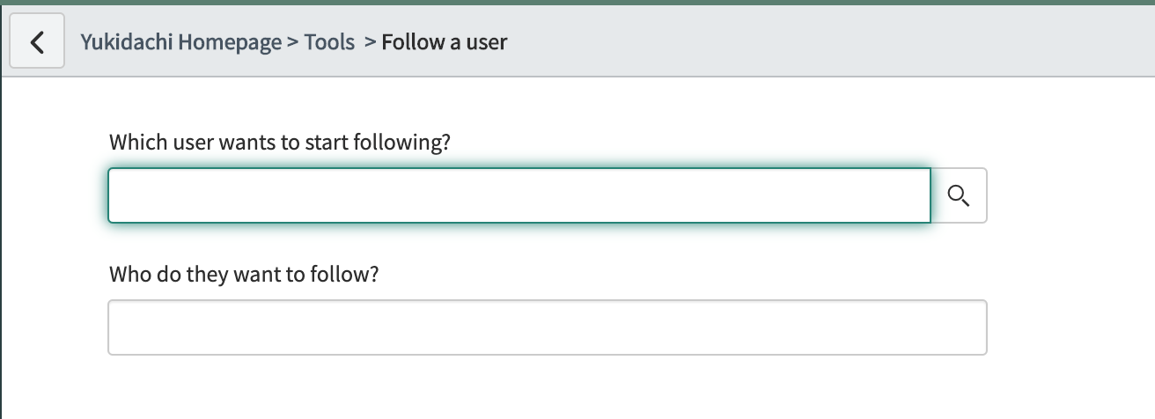
Yukidachi Followings
Table that shows which user is following another user
Created scripts and made REST API calls to get all the users and then follow the available users in the instance
Allows user to follow other users

Slide 9
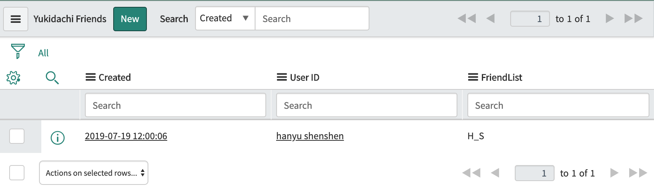
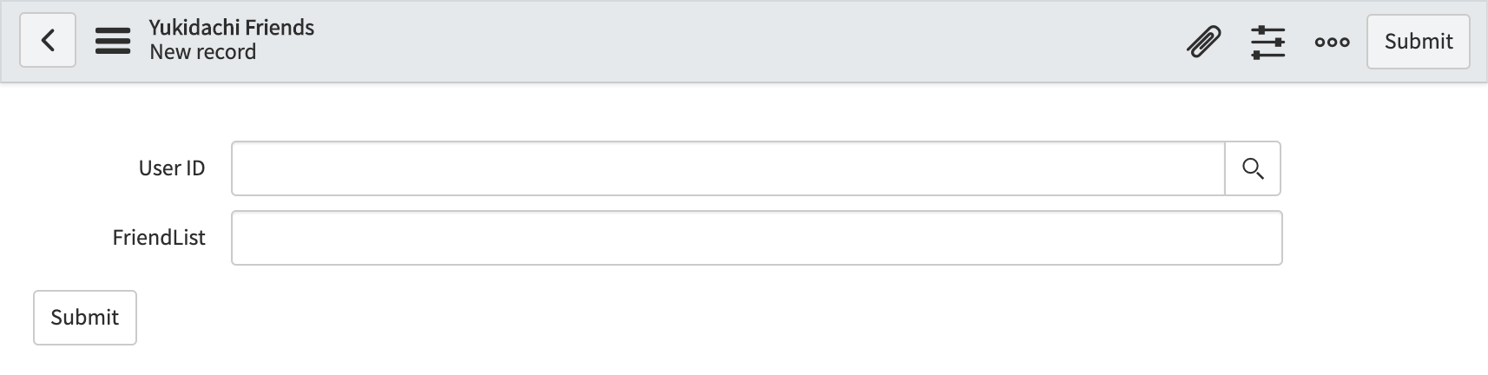
Yukidachi Friends
Table that shows which users are friends
Created scripts, made REST API calls, and scheduled jobs (that runs every minute) to update which users are following each other, so they can become friends
Form record that allows users to see their list of friends

